Slide 1
Crosswalk Church Preaching Presentation
Futakotamagawa Christian Church in Tokyo
Dr. Makoto Fukui

Slide 2
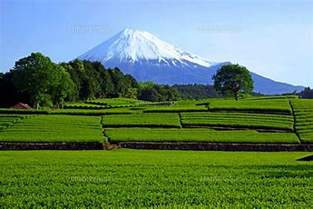
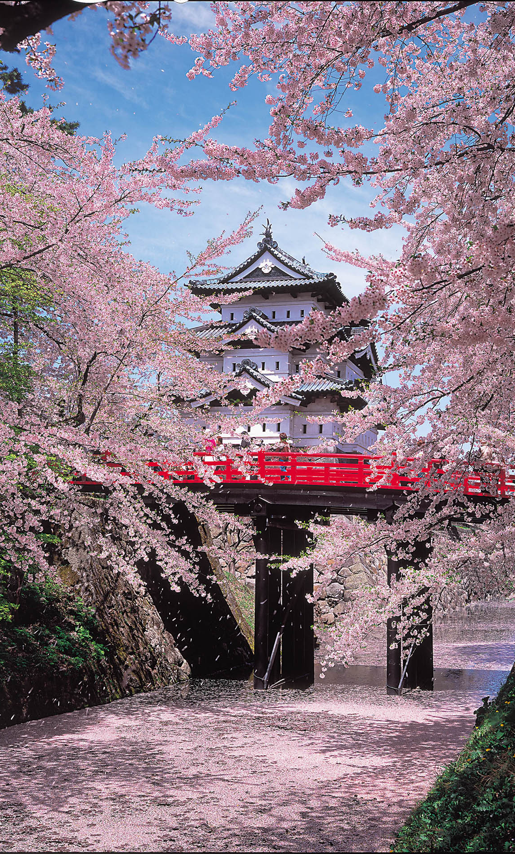
What kinds of images do you have when you hear the word “Japan”?

Slide 3
We represent the ministry in Japan. But it is not an easy ministry!
Japanese Christian Church Outlook
Structural View
Historical View

Slide 4
Historical View (1) Changes in the Number of Christian Followers in Japan
Protestant
Catholic
Population Ratio％ =0.78％（2018)
Orthodox

Slide 5
Historical View (2)
Changes in the Number of Protestant Churches and Believers
with what Evangelicals have done(1865-2014）
③Spiritual
Movement
(1993-）
Believers Number/ Population Ratio×10
Church Numbers
Church Number
②Church Growth Movement
(1970-）
①Crusade Evangelism
Billy Graham
Crusade
(1956-）
Kingdom Crusade
(1930-35）
Believers Numbers
20C Crusade
(1900）
Coop
Crusade
(1914-17）
WW2
Population Ratio%*10=0.48
Notes:
◎ 日本におけるプロテスタント宣教は、1858年日米修好通商条約締結後の翌年、1859年（安政六年）の米国宣教師の来日
によって開始された（琉球においては、それより13年前にベッテルハイムによる伝道が開始されている）。
この図は、1865年（慶応元年）から2014年までの、プロテスタント・キリスト教会の教会数及びクリスチャン人口の推移を示すもので
す。
1865年（慶応元年）に、宣教師バラの日本語教師であり漢訳のマルコ伝やヨハネ伝の邦訳を手伝っていた矢野元隆が、禁教下の
中で日本人として最初の受洗者となった。
また、1872年（明治五年）横浜に日本人を信徒とする最初のプロテスタント教会「日本基督公会」が設立された。日本人信徒11
人からなり、宣教師バラが仮牧師となった。
戦後は、約2,000弱の教会数からのスタートであったが、その後30年ほどの間に約3倍の6,000近くまで急速な伸長をしてきた。
しかし、1990年過ぎまでは増加傾向が続いていたが、その後の20年間は、教会数の増加は鈍化し、2000年前後に7,800
までに達 したが、現在はほぼ横ばいか、或は逆にやや減少傾向を見せている。

Slide 6
Historical View (3)
Christianity Waves and Social Fluctuation in Japan
Population Ratio
=Almost 3%
Japanese religious mind is very sensitive to social fluctuation
Population Ratio
= still under 1%
Anti-Christian Edict
Internationalism
MacArthur
Arrives
Military needs
Subway
Sarin
Incident
(Cult)
Releasing from the unequal Treaties
University
upheavals
Democratization
Militarism
State Sinto
1st
Francis Xavier
(Jesuit Catholic)
(1568-1600)
3rd
Taisho
Democracy
(1912-1926)
5th
High economic growth period
（After 1970）
2nd
Opening Japan
(1868-1912)
4th
After WWII
(1945-1960)

Slide 7
Historical View(4) Comparison of number of church members and number of worshipers (2004 - 2014)
 |  | 2004 | 2014
Number of Church Members | Average | 63.5 | 60.6
 | Median | 38 | 35
 | Mode | 20 | 20
 | Under 15 | 19.6% | 22.1%
 | Under 30 | 42.5% | 46.0%
 | Under 50 | 63.4% | 65.9%
Number of Worshipers | Average | 41.2 | 39.3
 | Median | 27 | 25
 | Mode | 20 | 20
 | Under 15 | 26.3% | 30.6%
 | Under 30 | 58.4% | 62.4%
 | Under 50 | 79.2% | 81.5%
Mode is less than 20; a lot of small churches in Japan
Japanese churches have tended to shrink as compared with ten years ago

Slide 8
Structural View (1) Current Situation of Japanese Christianity
The number of believers are almost the same, but there overwhelmingly more Protestant churches, pastors, and believers
 | Church Num. | Pastors’ Num. | Believers’ Num. | Popula-tion Ratio
Catholic | 990 | 1,450 | 450,000 | 0.36％
Orthodox | 70 | 50 | 10,000 | 0.01％
Protestant | 7,950 | 10,200 | 550,000 | 0.44％
Total | 9,010 | 11,700 | 1,010,000 | 0.81％
There are so many small protestant churches!

Slide 9
Structural View(2) Population distribution by size of residential area by religion
Religion | 13 Big City | Other City | Town /Village | Total
Buddhism | 15.3 | 54.4 | 30.3 | 100.0
Shinto | 15.2 | 59.5 | 25.3 | 100.0
Christianity | 25.5 | 57.8 | 16.7 | 100.0
Soka Gakkai | 23.2 | 59.8 | 17.0 | 100.0
New Religious (Other) | 18.9 | 65.4 | 15.7 | 100.0
Other | 17.1 | 57.7 | 25.2 | 100.0
Total | 16.4 | 55.8 | 27.8 | 100.0
Christianity is prevalent among people in large cities

Slide 10
Structural View(3) Population distribution by educational level by religion
Religion | Elementary | Junior | High School | Over University | Total
Buddhism | 16.2 | 21.8 | 35.9 | 26.1 | 100.0
Shinto system | 5.2 | 20.8 | 42.9 | 31.2 | 100.0
Christianity | 2.0 | 6.9 | 39.2 | 52.0 | 100.0
Soka Gakkai | 15.3 | 25.7 | 41.0 | 18.0 | 100.0
New Religious (Other) | 9.8 | 25.1 | 39.3 | 25.7 | 100.0
Other | 24.6 | 34.4 | 27.9 | 13.1 | 100.0
Total | 15.4 | 22.2 | 36.5 | 26.0 | 100.0
Christianity is widely accepted by those college- level educated and above.

Slide 11
Structural View (4) Population distribution by income level (in yen) by religion
Religion | 0-2.5 Million | 2.5-5.0 Million | 5.0-7.5 Million | Over 7.5 Million | Total
Buddhism | 40.1 | 21.6 | 21.5 | 16.7 | 100.0
Shinto system | 35.7 | 28.6 | 16.7 | 19.0 | 100.0
Christianity | 38.9 | 20.4 | 25.9 | 14.8 | 100.0
Soka Gakkai | 50.0 | 29.8 | 13.2 | 7.0 | 100.0
New Religious (Other) | 51.6 | 17.6 | 17.6 | 13.2 | 100.0
Other | 52.3 | 34.1 | 6.8 | 6.8 | 100.0
Total | 41.7 | 22.5 | 20.3 | 15.5 | 100.0
Christianity is prevalent in middle-class income level.

Slide 12
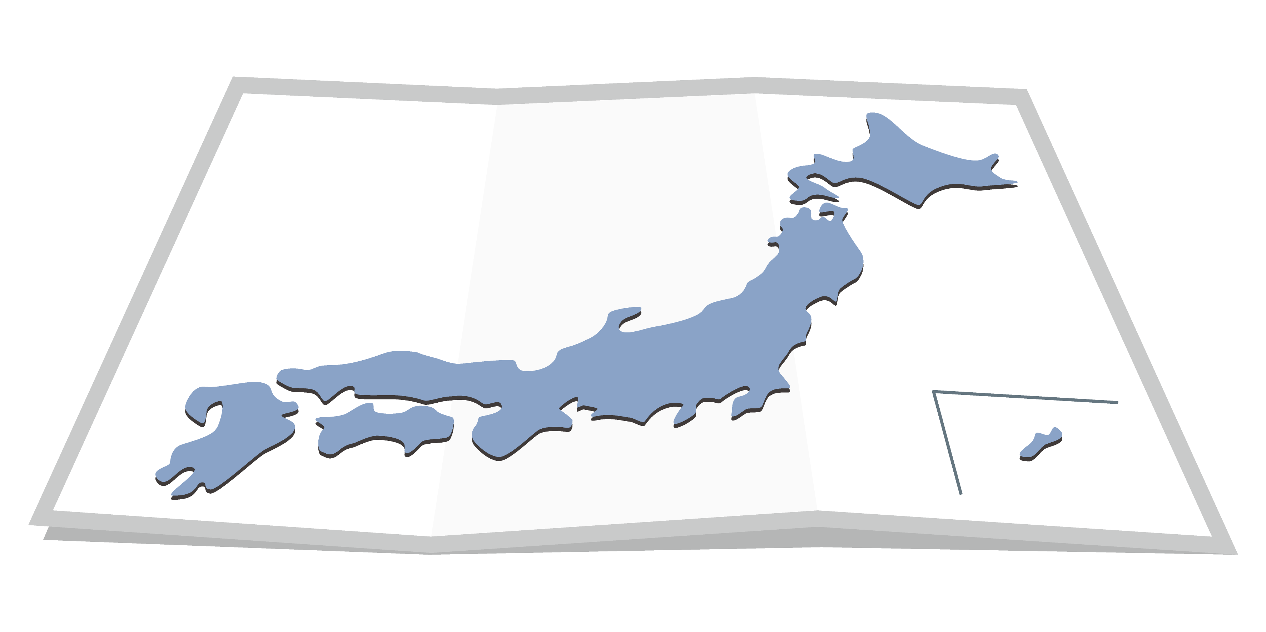
Structural View(5) Current Situation of Japanese Christianity
60% of 8000 churches, almost 4,800 churches, have not baptized any persons every year. More than half of the churches are dysfunctional about spiritual harvest.
The average number of baptisms is 0.79 person per church every year.
Some churches are growing from conversions, but many are not. Most increase in numbers is from believers moving between churches. That means growth potential is weak for the future of the church.

Slide 13
Population Ratio：1.5％Growth Rate：4.5-5.0%
30-member church- 1.0
100-memberchurch -5.0
(2044 Population：100 M）
Prediction
Constant
Church Number
Number of
Church Member
Population Ratio：0.8％
Growth Rate：2.5-3.0%
(status quo)
Mortality Rate: 1.5 ％
Population Ratio： 0.48 ％
（2014 Population: 127M)
Mortality Rate: 2.0 ％
Notes:
◎ この図は、『キリスト教年鑑』1948年版（データは1946年）以降による日本のキリスト教信者（カトリック、オーソドックス、
プロテスタント）の推移を示すものです。
教会員数は、ここ15年以上約55万人前後、人口比では0.4％台で推移し、カトリック、オーソドックス含めても、対人口比は
戦後一度も1％の壁を超えることなく、低迷している。
実質的な活会員数に近い礼拝者数においても同じように横ばい状態であり、人数としては教会員数の約50％で、
人口比0.2％台で推移しているのが現状である。

Slide 14
Let’s Think Tough Ministry in Japan
Japan is said to be the graveyard of missionaries
Many missionaries and Japanese pastors are unable to raise missionary results
What is the cause?⇒Three aspects of the cause
②receiver (object)
Japanese Society
①sender (subject)
Church
③Communication
means

Slide 15
Three Aspects of difficulties Sender (Subject)
Pastor:
Believer:
Church:
Denomination:
Academic, not practical personality
Spiritually immature, profit-oriented
60% of churches powerless, not connected to the community
Institutional fatigue for effective evangelism

Slide 16
Three Aspects of difficulties Receiver (Object)
People:
Community:
Social:
Group thinking, Syncretism, Profit-oriented
Closed and rigid society, Company-Oriented
Nationalism is a cultural barrier to the Religious Seeker; Performance-based system; Need Expanding the Christian market (Christianity is not widely accepted culturally)

Slide 17
Three Aspects of difficulties Transmission means
Connect and build relationships to other people groups: Educational and Income levels, and Geographical areas.
Speak into people’s needs by culturally relevant means
Deep commitment to infiltrate the closed community mindset

Slide 18
Tough Ministry in Japan？ Yes, but God planned
When the Gentiles heard this, they were glad and honored the word of the Lord; and all who were appointed for eternal life believed. (Act 13:48)

Slide 19
Case of Jeremiah: Calling to the ministry just before the Babylonian destruction. It was also a tough ministry.

Slide 20
Word Play in Jeremaiah 1:11,12
Verse 11
The word of the LORD came to me: "What do you see, Jeremiah?"
"I see the branch of an almond tree (dqev’),(shakeid)" I replied.
Verse12
The LORD said to me, "You have seen correctly,
for I am watching (dqevo)(shokeid) to see that my word is fulfilled."
The Hebrew for <watching> sounds like the Hebrew for <almond tree.>

Slide 21
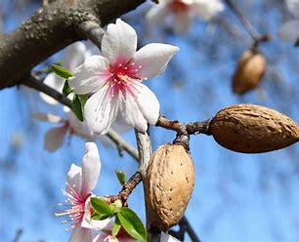
The background of word play in verses 11,12 and connection with verse 5

Slide 22
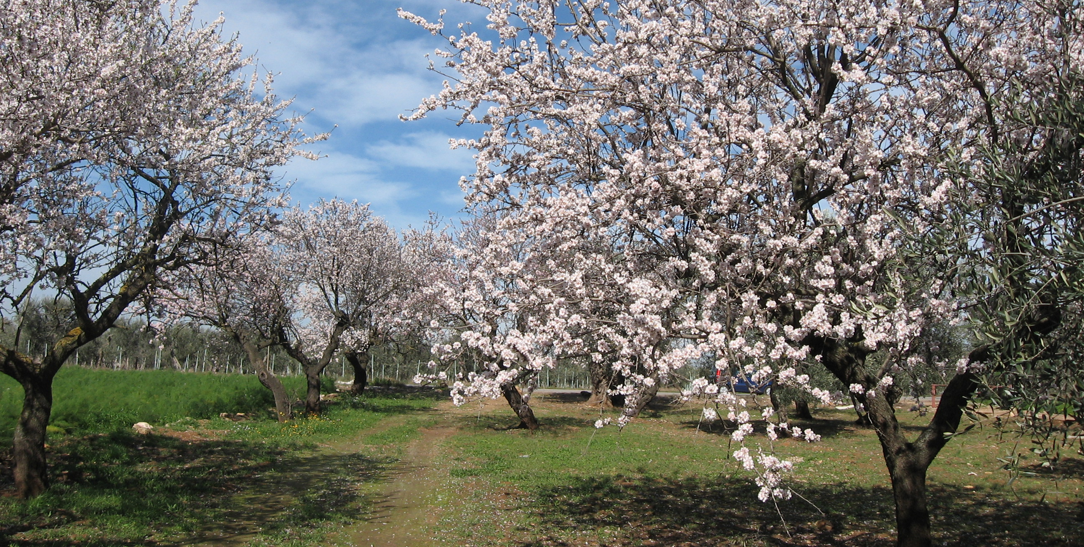
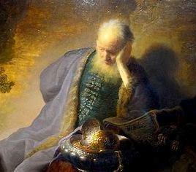
The Word Play is preaching
God has watched like an almond tree from before Jeremiah was born and appointed him as a Prophet.
God’s word encourages Jeremiah who is is involved in a very tough ministry just before the destruction of Jerusalem.
We should know every opportunity and ministry is well planned and prepared by God whether we wee the final outworking of it or not.

Slide 23
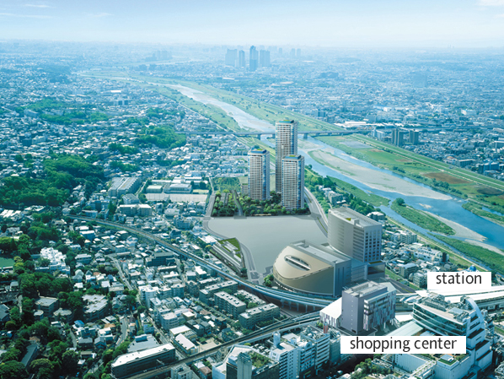
WELCOME TO FUTAKO TAMAGAWA
Kanagawa Science Park
(Technological Company Region)
Rakuten Co.Ltd. HQ
Notes:
http://house.goo.ne.jp/chiiki/town/detail/2324070/index.html
Futakotamagawa is famous for new development area in Tokyo. As you know Tokyo is very crowded with building, but it is know for the feeling of release made by river and green, and many people in show business and Western foreigner lives in this area as well as returnee people from Western.
玉川高島屋を中心とする二子玉川駅周辺は、芸能人も多く住んでいることで知られている。最近、高島屋がさらに新館を建てるなど、以前にも増して、大型のデ パートやお店がたくさんできたため、都心まででなくても、何でも揃う。 毎年恒例の多摩川花火大会には大勢の人が集まるこの街は、バス系統も多く、タクシー乗り場もあるため交通の利便性は高い。また、山河の湯という温泉もあ り、平日、土日を問わず、多くの人でにぎわいをみせている。

Slide 24
Conclusions We welcome various missionary candidates who will take up the challenge of tough ministry in Japan.
Pray
Pray for the soul of Japan, Christians, missionaries, Japanese pastors.
Send
Send missionaries to Japan.
Encourage
Support and encourage missionaries who face tough ministry.

